Slide 1

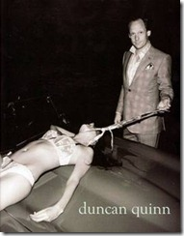
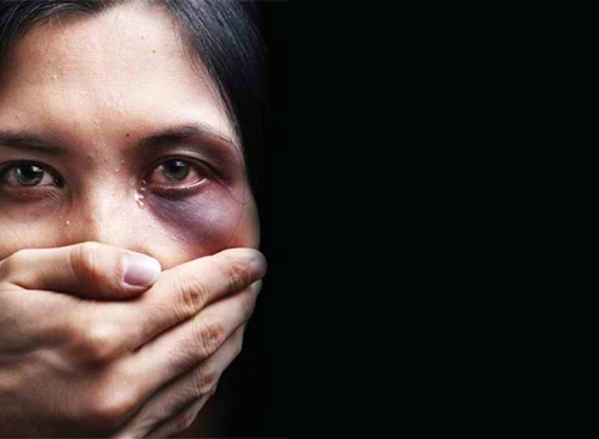

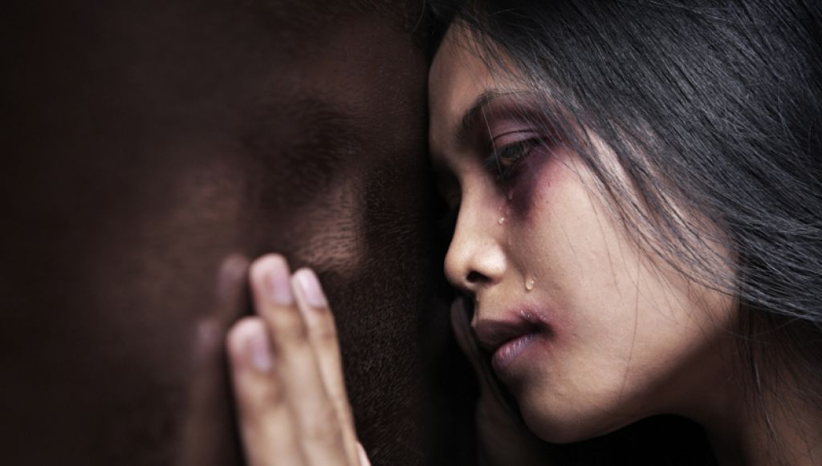
PERPECTIVE OF SELECTED MEDIA PRACTITIONERS AND PERSONALITIES ON FIGHTING VIOLENCE AGAINST WOMEN IN THE PHILIPPINE MEDIA
PREPARED BY :
ARNOLFO ABACIAL
JUSTINE DE VERA
WENNIELYN JUSAY

Slide 2
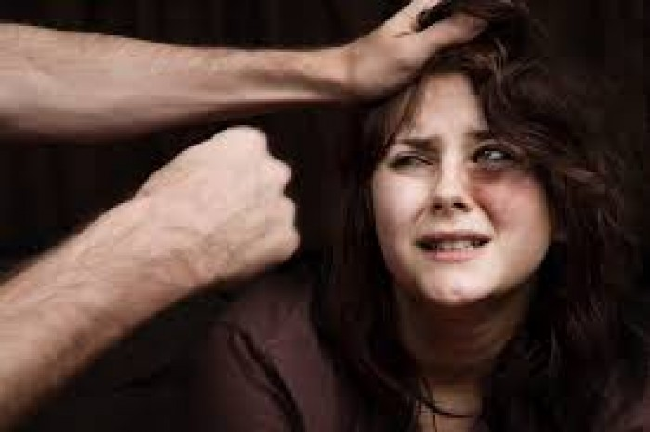
INTRODUCTION
Violence against Women is any act of gender-based violence that results harm physically, sexually or psychologically or women suffering
(UN Development Programme, n.d)

Slide 3

1 in every 4 women experience violence in her lifetime

Slide 4

In Philippines
Philippine National Police, 2016
Rape Cases and Violence on Women’s Right
2015 - 5,069
2016- 8,288

Slide 5







Media involved on VAW

Slide 6


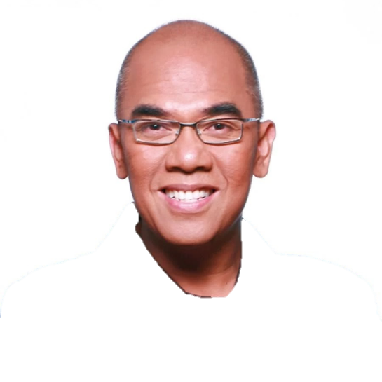

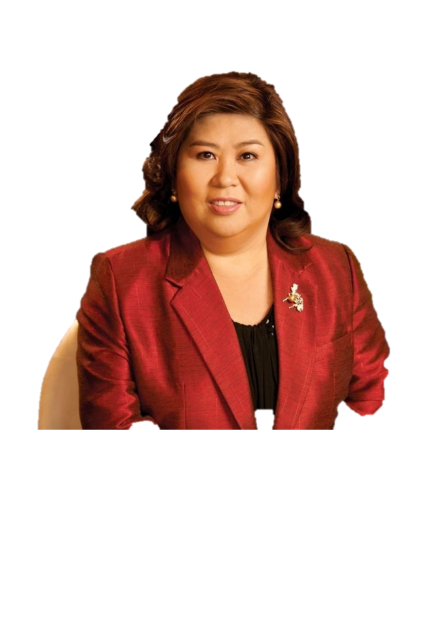


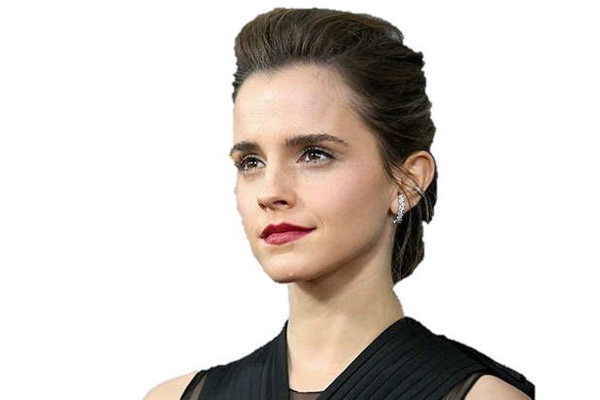
Advocate of Women’s Right
Global
Local

Slide 7
STATEMENT OF THE PROBLEM
what is the perspective of different selected media practitioners and personalities towards presentation of Violence against women in the Philippine media and how media can help prevent VAW?

Slide 8


OBJECTIVES
What is the profile of selected media practitioners and personalities?
What is the prevalence of violence against women in the media industry as perceived by practitioners and personalities?

Slide 9


How do media practitioners and personalities use their work to fight violence against women?
What are the challenges faced by media practitioners and personalities in promoting anti-violence against women campaigns and programs through their profession?

Slide 10

How do media practitioners and personalities cope with the challenges they face in promoting anti-violence against women campaigns and programs through their profession?
What is the role of media in anti-violence against women as perceived by the informants?

Slide 11

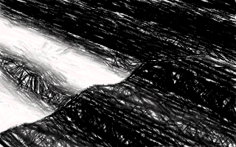
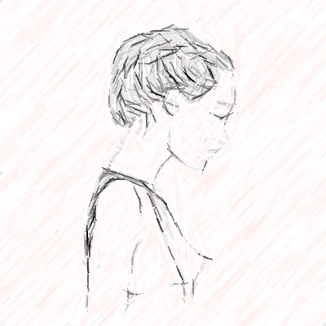
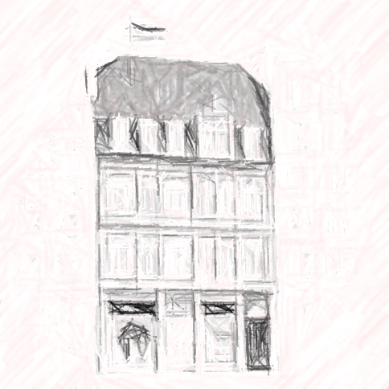
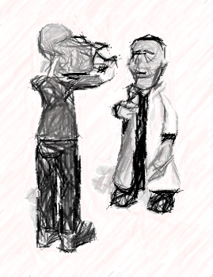
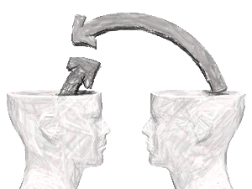

SIGNIFICANCE OF THE STUDY
To the:
Researchers
Respondents
Government
Academe
Society
Women
Media
Future Researchers

Slide 12
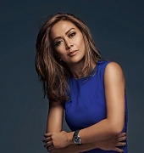


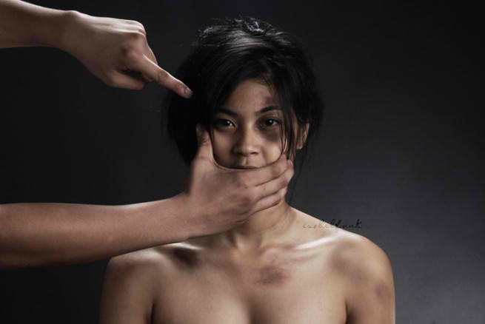
CHAPTER 3

Slide 13

RESEARCH DESIGN
QUALITATIVE RESEARCH APPROACH
focused on narrative that seeks to tell story of a certain person or group’s experiences, opinions, beliefs and perspective, in their own words (Kumar, 2011).

Slide 14
THE KEY INFORMANTS AND SELECTION TECHNIQUES
Among the non-probability sampling techniques, the researchers will utilize the purposive sampling where the informants were chosen according to the researchers’ set of criteria.

Slide 15
CRITERIA
Must be a media practitioner/ personality
Must be an advocate of women’s right
Must have contribution/s on anti-VAW in media
Must have at least 5years working experience in media

Slide 16
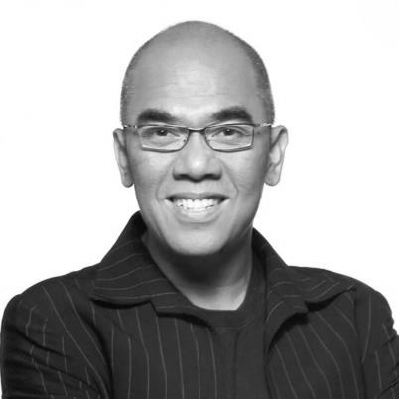
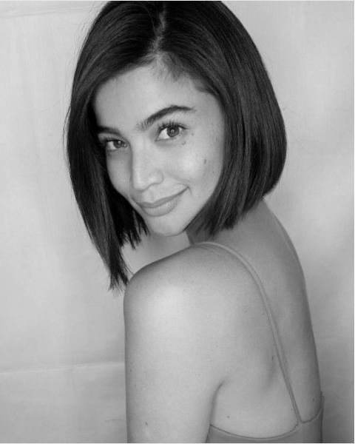
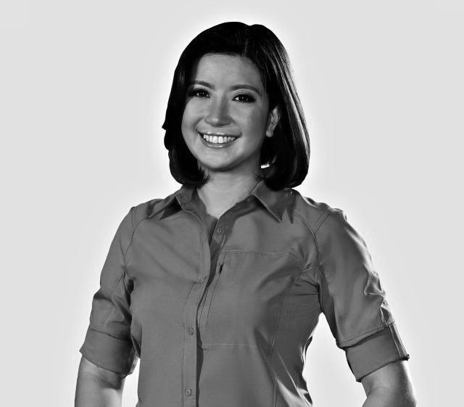
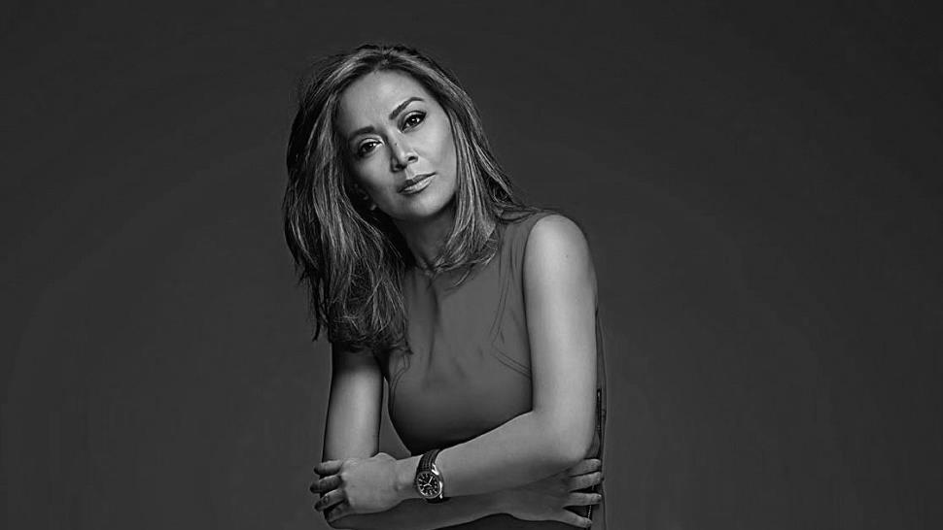
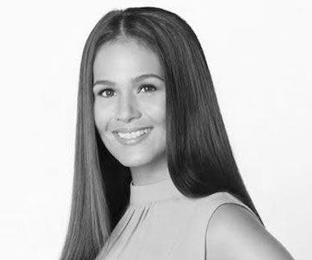

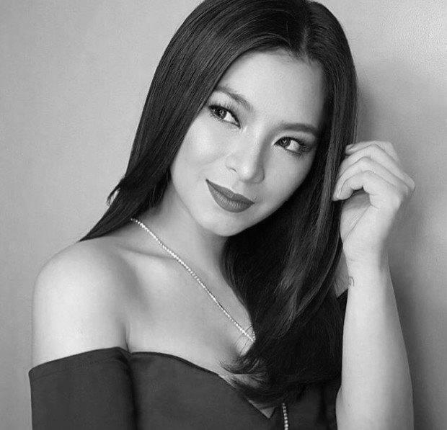
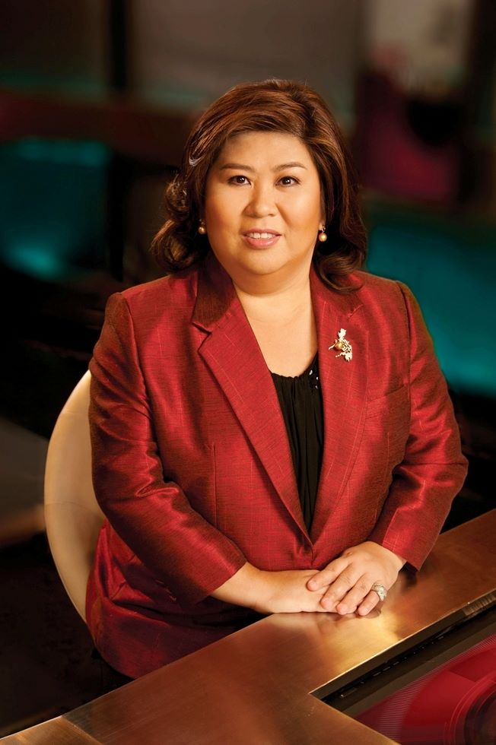
TARGET PARTICIPANTS

Slide 17

SOURCES OF DATA
The researchers will gather the primary data for the study through interview to seek the participants’ opinion and beliefs towards Violence against Women (VAW).

Slide 18
INSTRUMENTATION
The primary data of this study will use an interview guide to provide initial information for the actual structured interview of its participants. The interview guide is essential in using partial time available in conducting the interview, building it organized and systematic (SAGE, 2004).

Slide 19

ETHICAL CONSIDERATIONS
the researchers will be using informed consent to certify that the participants agreed on the terms and conditions during the interview
information during the interview strictly confidential
- the information on the interview will only be used for research purposes only

Slide 20
GOD BLESS

